Slide 1
Need Finding

Slide 2
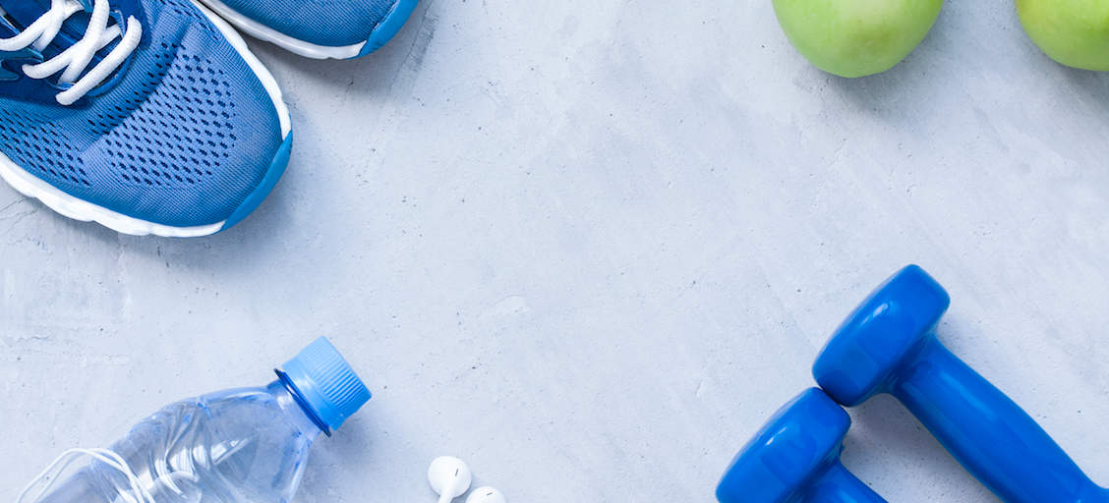
HealthPal - Your one stop fitness solution

Slide 3
Title Description
We aim to create a Health monitoring app that tracks and reminds user of their goals and caution them in case of any issue.The following parameters are tracked:
Health Parameter Monitoring
BP
Sugar
Heartbeat
O2 monitoring
Sleep Tracking
Fitness Monitoring
Steps
Distance
Calories Burnt from steps
Calories burnt in each category like cardio,weight lifting
BMI
3. Bad habit monitoring
a. Alcohol
b. Smoking

Slide 4
Empathy Maps
Total of four persons of different age brackets were interviewed.
Teen Empathy Map ( < 20 years)
Youth Empathy Map (20 - 30 years)
Middle Aged Empathy Map (30 - 60 years)
Senior Citizen Empathy Map ( > 60 years)

Slide 5
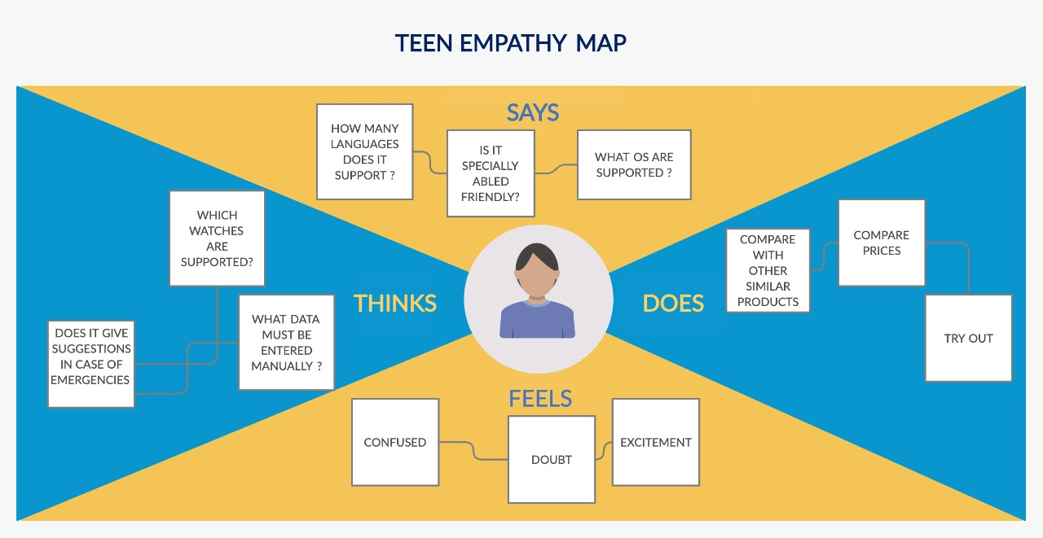

Slide 6
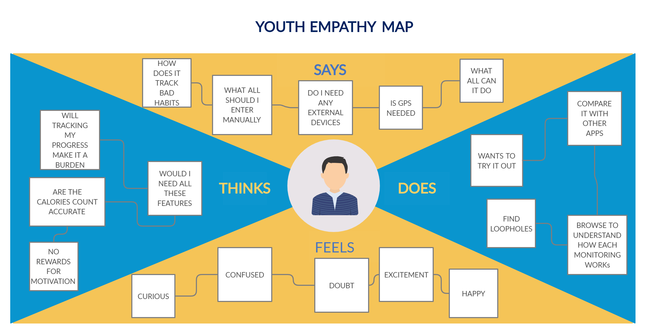

Slide 7
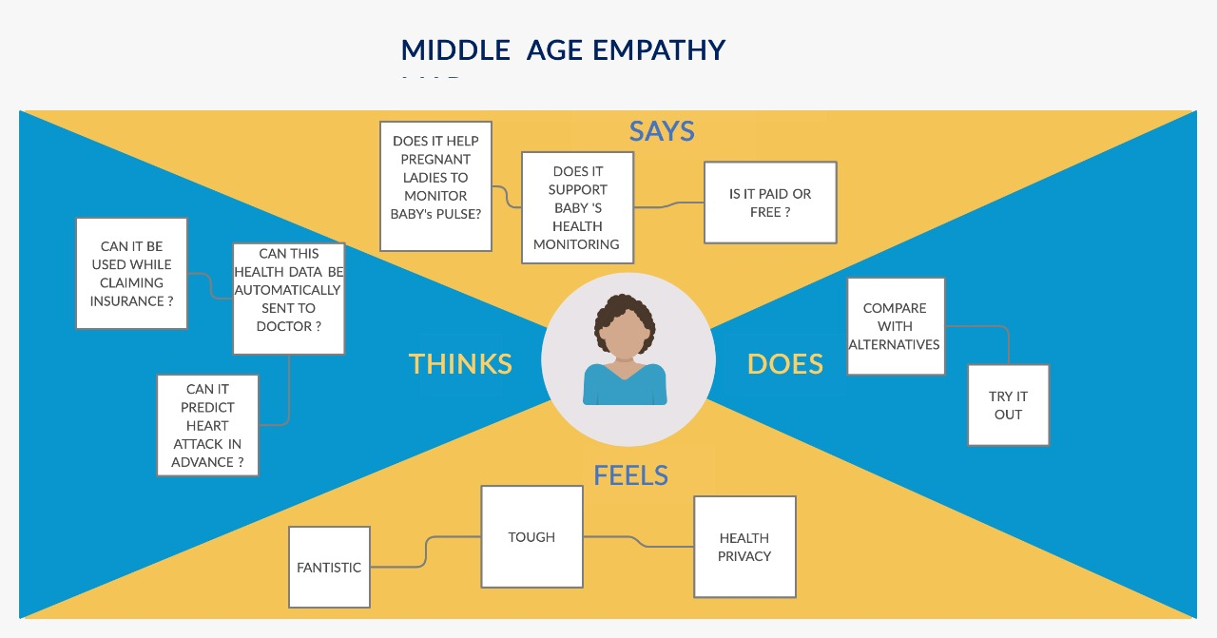

Slide 8
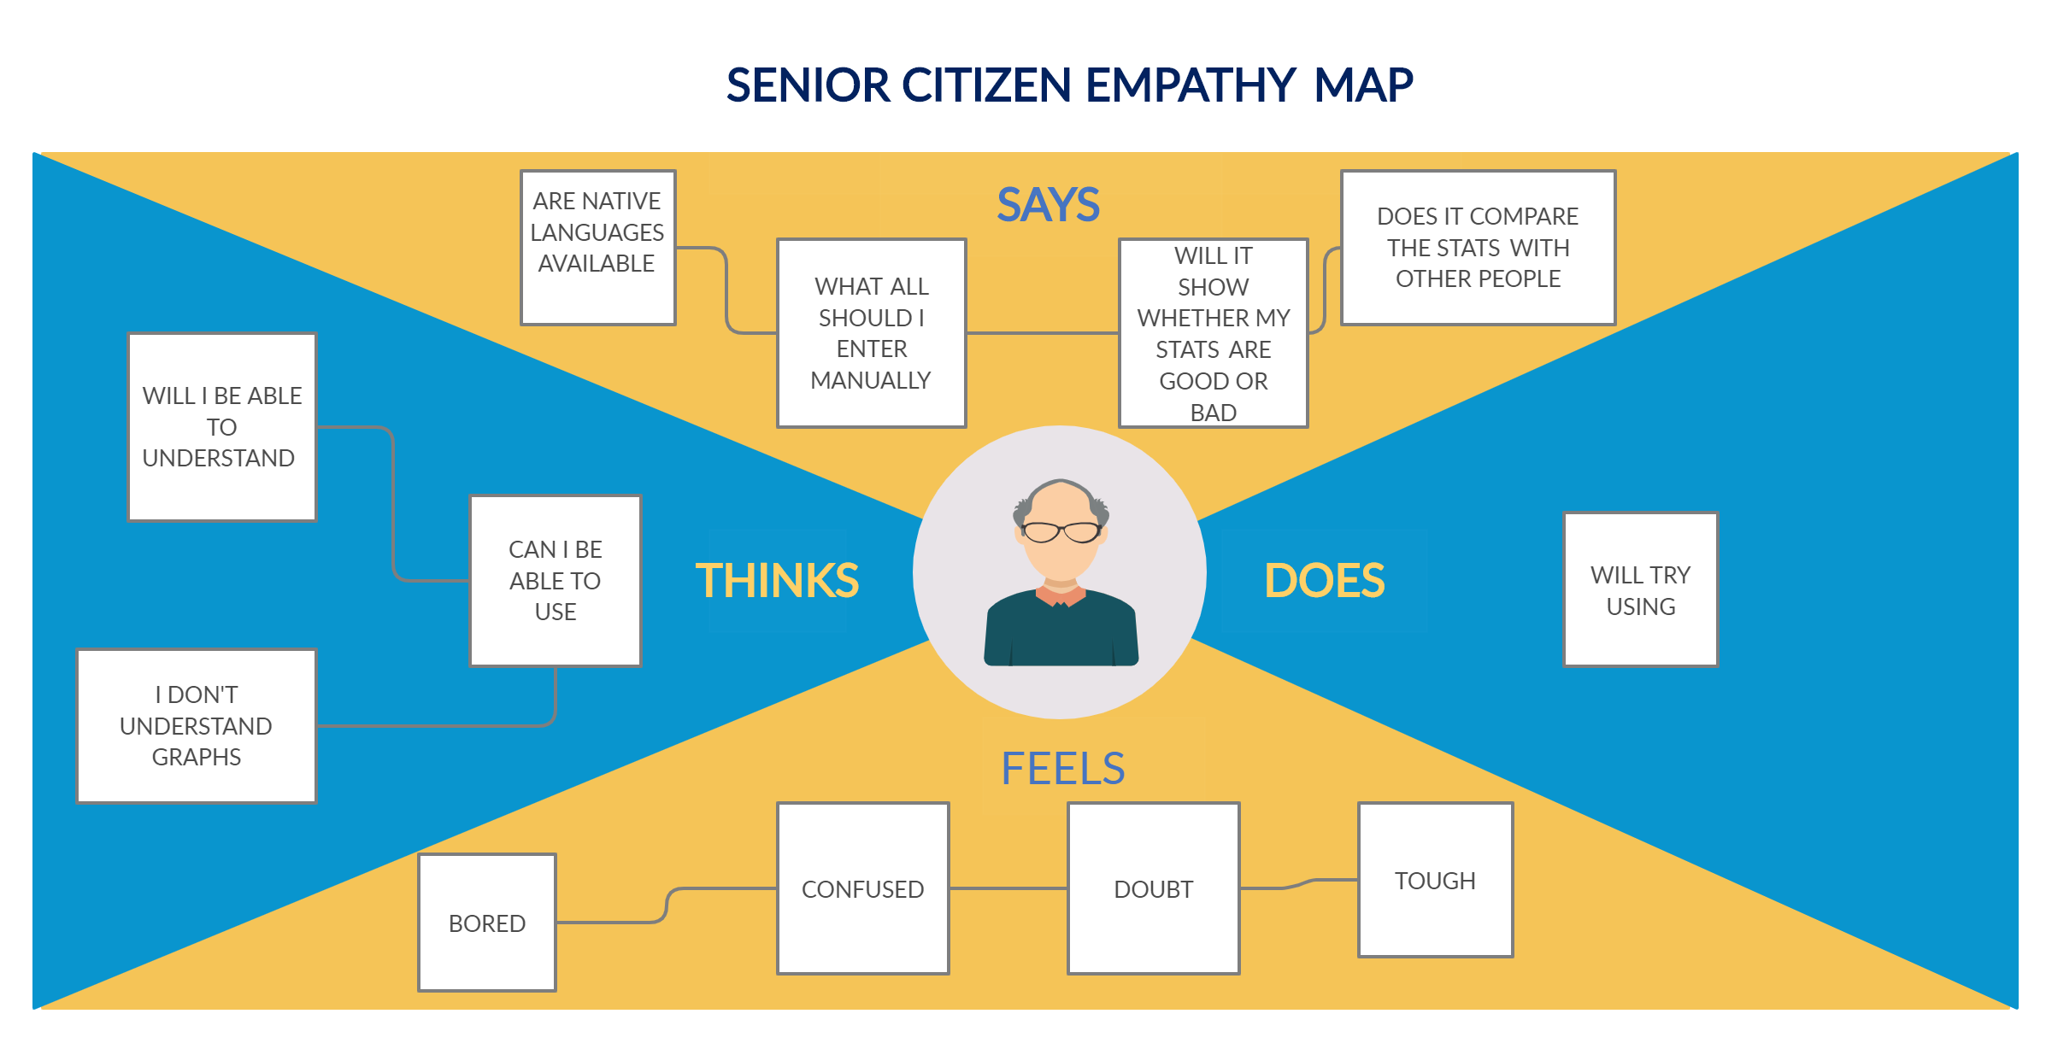

Slide 9
Key Insights
Say
Comparison of fitness measurement with other users
Native Language support
Features that are available
Think
Ease of use
Accuracy of the data
Feel
Privacy issues
Confusion with graphs
Do
Checking similar existing products

